Slide 1
Search Table

Slide 2
Virtual Documents 术语
Document Type Identify : schema definition and message structure
Building a map or parsing the message: apply message structure
Each schema definition represent a complete EDI standard, contains hundreds of message structure
Schema category: 2.1, 2.2...custom schema
Segment and fields
PID:1::000616898;;;A;MR~00531098;;;;PI::LaRocca;Yan::19980202:F::4:924 Maple Blv
Virtual property
Virtual property path: syntax Ensemble use to specify virtual property
schema plus structure plus segment plus Field
Notes:
Selectable endpoints for testing multiple systems
Provides quick and easy access to the message trace and SOAP log for a test message
Does not require the full HealthShare UI (Viewer Portal) to function

Slide 3
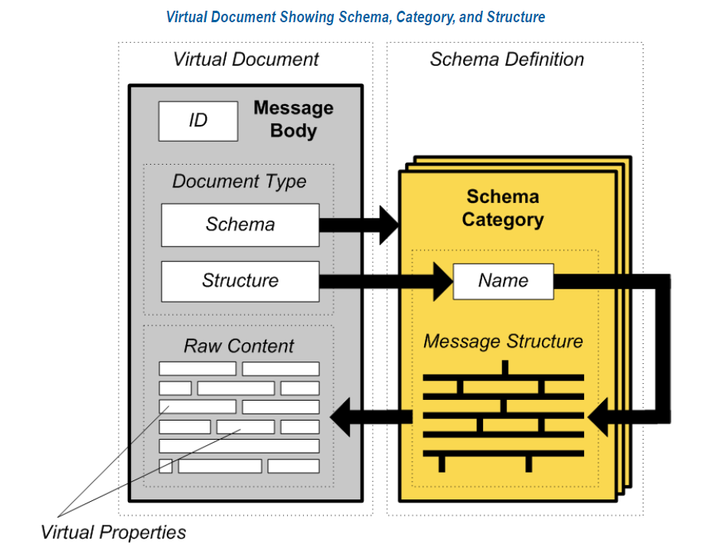
虚拟文档VDoc

Slide 4
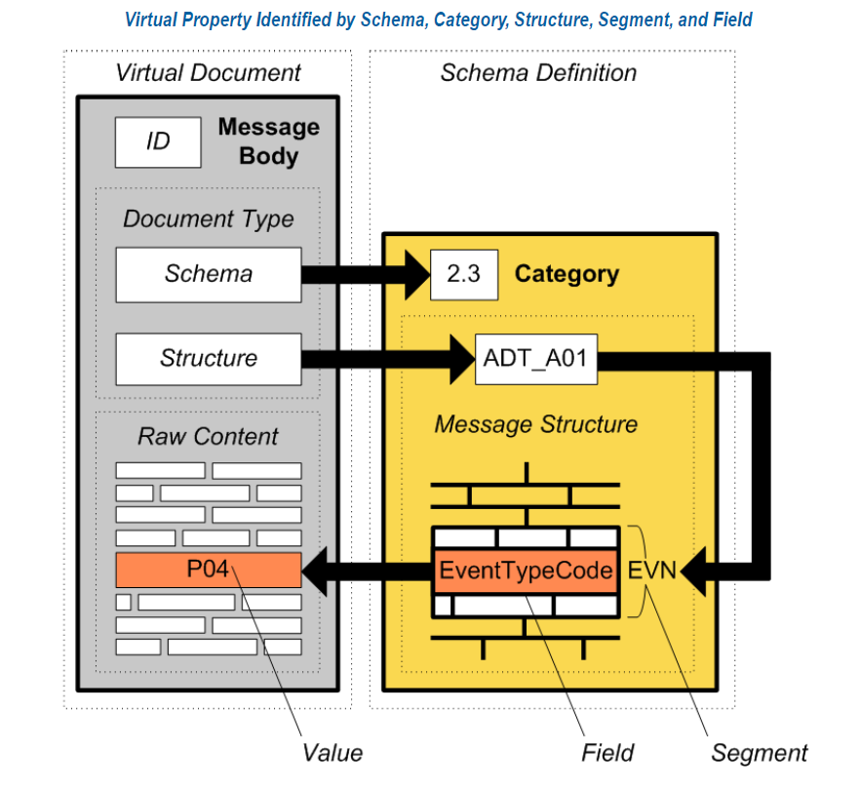
虚拟文档VDoc

Slide 5
Search Table概念
Search table用来定位虚拟文档里的内容，用来做过滤或者搜索。 用在Message Browser, Rules Editor, and other parts of the Ensemble Management Portal.
虚拟文档因为没有建立OBJECT实例，里面的内容不方便搜索
Serach Table实际上是在虚拟文档按某些字段做索引。
做了索引的virtual Property可以很快的查找到。

Slide 6
EnsLib.HL7.SearchTable
already provides entries for popular HL7 properties:
MSHTypeName
MSHControlID
PatientID
PatientName
PatientAcct
如果需要搜索更多的字段，可以创建一个类来继承上面的类

Slide 7
Enslib.hl7.searchtable
/// Defines a set of properties derived from Document objects of class 'EnsLib.HL7.Message' /// that can be used in SQL to locate and join to messages of interest. Class EnsLib.HL7.SearchTable Extends (%Persistent, Ens.VDoc.SearchTable) [ ClassType = persistent, CompileAfter = EnsLib.HL7.Message, Inheritance = right, ProcedureBlock, System = 4 ] { Parameter DOCCLASS = "EnsLib.HL7.Message"; Parameter EXTENTSIZE = 4000000; /* Re-declare indices because the superclass is abstract */ Index indexValue On (PropId, PropValue, DocId) [ IdKey, Unique ]; Index indexDocId On (DocId, PropId, PropValue) [ Unique ]; XData SearchSpec [ XMLNamespace = "http://www.intersystems.com/EnsSearchTable" ] { <Items> <Item DocType="" PropName="MSHTypeName" >{1:9.1}_"_"_{1:9.2}</Item> <Item DocType="" PropName="MSHControlID" PropType='String:CaseSensitive' >{1:10}</Item> <Item DocType="" PropName="PatientID" >[PID:2.1]</Item> <Item DocType="" PropName="PatientID" >[PID:3().1]</Item> <Item DocType="" PropName="PatientID" >[PID:4().1]</Item> <Item DocType="" PropName="PatientName" >[PID:5()]</Item> <Item DocType="" PropName="PatientAcct" >[PID:18.1]</Item> </Items> }

Slide 8
More search tables
Document Type | Default Search Table Class | Notes
HL7 | EnsLib.HL7.SearchTable | Indexes a set of commonly needed properties; see “Properties That Are Indexed by Default” in theEnsemble HL7 Version 2 Development Guide.
X12 | EnsLib.EDI.X12.SearchTable | Indexes the Identifier property, which corresponds to the X12 document ID.
ASTM | EnsLib.EDI.ASTM.SearchTable | Indexes the Identifier property, which corresponds to the ASTM document ID.
EDIFACT | EnsLib.EDI.EDIFACT.SearchTable | Indexes the Identifier property, which corresponds to the EDIFACT document ID.
XML | EnsLib.EDI.XML.SearchTable | Indexes the name of the root element of the XML document.

Slide 9
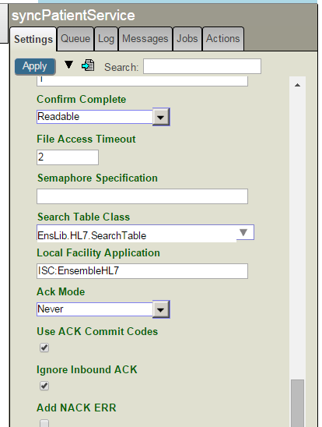
Configure search table in Business hosts
To use the search table class, specify it as a configuration option (called Search Table Class) for the applicable business host. When that business host processes messages, it uses the configured search table class to index those messages.
BS
EnsLib.HL7.Service.FileService
EnsLib.EDI.EDIFACT.Service.FTPService

Slide 10
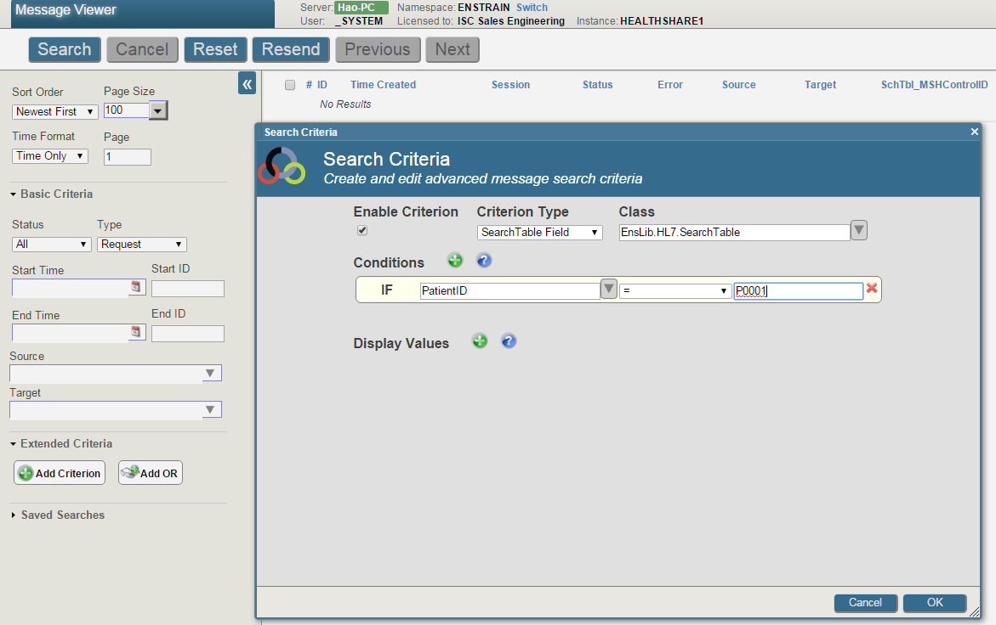
Search table in message viewer

Slide 11
EnsLib.XML.SearchTable
EnsLib.EDI.XML.SearchTable

Slide 12
EnsLib.XML.SearchTable
EnsLib.EDI.XML.SearchTable

Slide 13
Publish and Subscribe
发布和订阅

Slide 14
Overview
基本上，Publish and Subscibe是基于Ensemble消息的路由， 路由由BP管理，可以发送到多个目标BP或者BO
基于消息的topic, 用户(Subscriber)可以订阅消息
当消息被PUBLISH BP收到，该BP可以把该消息路由
topic是以下格式的字符串：topic.sublevel1.sublevel2.sublevel3
books
books.fiction
books.fiction.latin
books.*.latin
(注意*的用法和普通regular expression里面不同, 文档有解释， 有很多出人意料的地方， 比如订阅books.*, 收不到topic是books的消息。

Slide 15
Overview2
用户(Subscribers): 一个User或者一个Business host
Name
Target: Business Operation Name
Subscription: 定义用户和topic的关联
Abel订阅了明确的两个消息
Baker订阅了一个明确消息，还有关于病人lab检查的消息
Charlie订阅了ID为X3562564的任何医生病人有关的消息
Subscriber | Topic
Abel | Doctor.ICU.88494
Abel | Doctor.ICU.88495
Baker | Doctor.ICU.88495
Baker | Patient.LAB.*
Charlie | *.*.X3562564

Slide 16
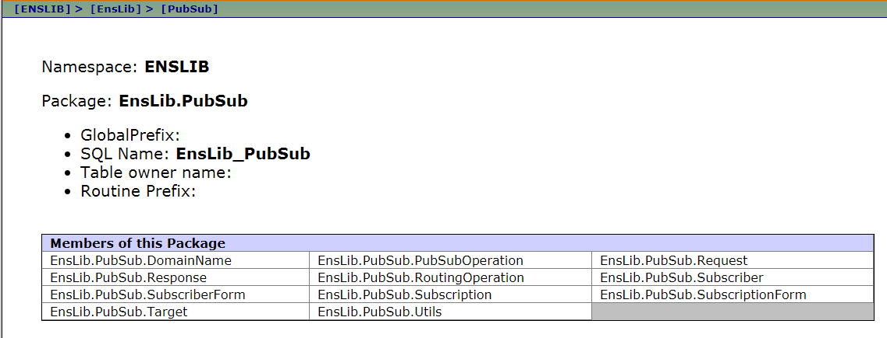
Implementation 1
Note: EnsLib.PubSub.PubSubOperation is a subclass of EnsLib.PubSub.RoutingOperation

Slide 17
使用PubSub-创建DOMAIN
用户可以是一个用

Slide 18
创建用户
A subscriber is an entity (a user or an external system) that might be interested in a specific topic or set of topics. A subscriber entry specifies how that entity wishes to be contacted; that is, how Ensemble should send a message to it.
上面的external system很明确，可以是一个BO或者BP, 处理PubSub的BP收到PubSubOperation发回来的订阅列表，生成一个消息到目标。
如果是一个User, 怎么定义发给谁呢？
以下是Enslib.PubSub.Subscriber extens Enslib.PubSub.Target里的定义
property Address as %String(MAXLEN=128,XMLPROJECTION="ATTRIBUTE");
(optional) External address used to send the message. (For example, an e-mail address).
property Target as %String(MAXLEN=128,XMLPROJECTION="ATTRIBUTE");
Target to which message should be sent. This is the name of a configured Business Process or Operation within the current production.

Slide 19
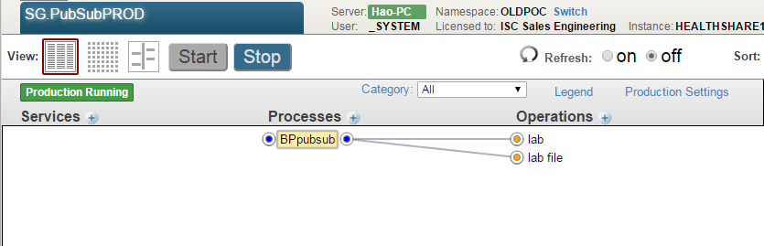
Sample production

Slide 20
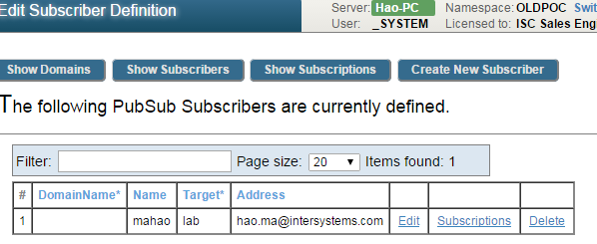
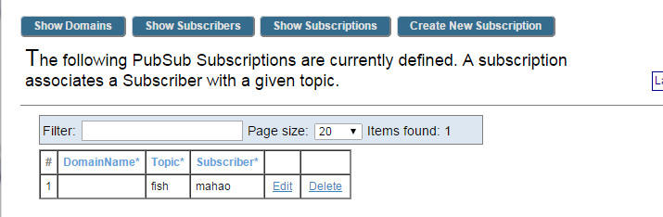
Create subscriber and subscription

Slide 21
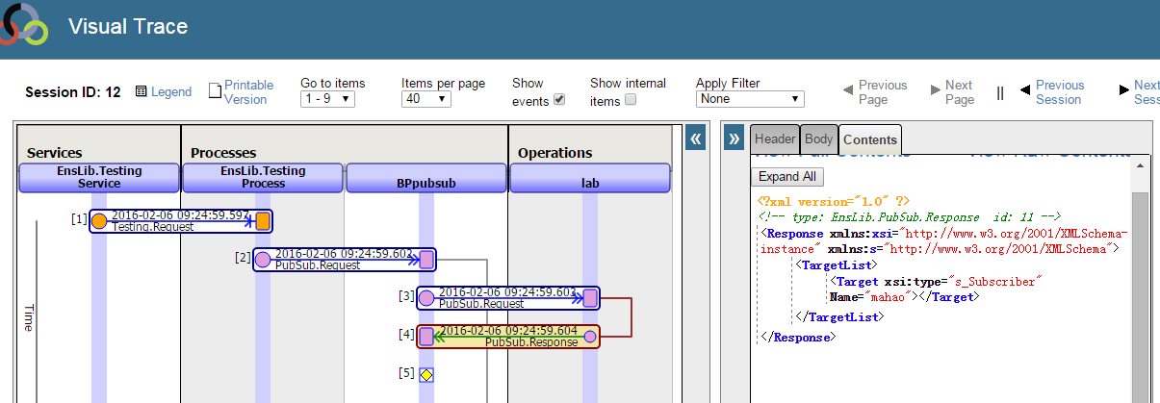
PubSub Operation return subscriber which is interested in the topic

Slide 22
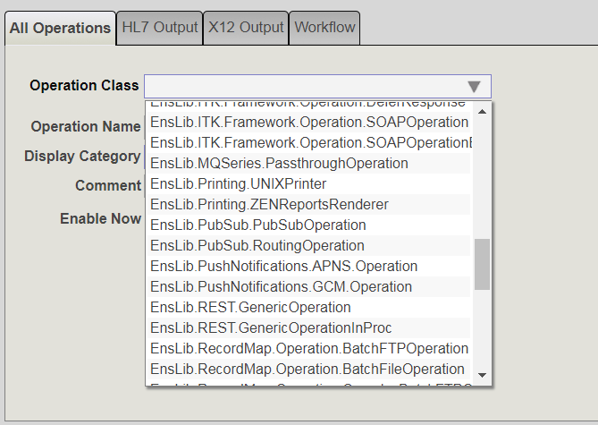

Slide 23
EnsLib.PubSub.Response
Response里面有个TargetList, 不知道为什么当在BP的call action里面构建对应关系的时候显示很意外，注意这时候干脆自己写，不用系统产生的连线方式。
Class EnsLib.PubSub.Response Extends Ens.Response [ ClassType = persistent, ProcedureBlock, System = 4 ] { /// Use our own domain for localization Parameter DOMAIN = "Ensemble"; /// List of targets to which the message should be sent. Property TargetList As list Of EnsLib.PubSub.Target; /// Make sure non-subscriber target objects are deleted when then /// *this* response is deleted. ClassMethod %OnDelete(oid As %ObjectIdentity) As %Status { Set id = $$$oidPrimary(oid) &sql(DELETE FROM EnsLib_PubSub.Target WHERE %CorrespondingResponse = :id) Quit $$$OK } Storage Default{}
}

Slide 24
EnsLib.PubSub.Request/Response
Request消息3个property都是optional, 实际使用一般是发一个topic
测试BP直接用EnsLib.PubSub.Request就可以
class EnsLib.PubSub.Request extends Ens.Request
property DomainName as %String(MAXLEN=100); Optional publish/subscriber domain name; used for PubSub routing.•
property Message as Ens.Request; Optional message to be routed.•
property Topic as %String(MAXLEN=1000);Optional topic string; used for PubSub routing.
class EnsLib.PubSub.Response extends Ens.Response
property TargetList as list of EnsLib.PubSub.Target; List of targets to which the message should be sent.
classmethod %OnDelete(oid As %ObjectIdentity) as %Status Make sure non-subscriber target objects are deleted when then *this* response is deleted.

